Slide 1
Sensors – Display the Orientation Sensor Information

Slide 2
Outlines
Sensors overview
Introduction to sensors
Sensor framework
How to use sensors
Identifying sensors and its capabilities
Monitoring sensor events
Lab task specifications

Slide 3
Sensors Overview
Most Android-powered devices have built-in sensors that measure motion, orientation, and various environmental conditions. These sensors are capable of providing raw data with high precision and accuracy, and are useful if you want to monitor three-dimensional device movement or positioning, or you want to monitor changes in the ambient environment near a device.
For example, a game might track readings from a device's gravity sensor to infer complex user gestures and motions, such as tilt, shake, rotation, or swing. Likewise, a weather application might use a device's temperature sensor and humidity sensor to calculate and report the dewpoint, or a travel application might use the geomagnetic field sensor and accelerometer to report a compass bearing.

Slide 4
Categories of Sensors
Motion sensors
These sensors measure acceleration forces and rotational forces along three axes. This category includes accelerometers, gravity sensors, gyroscopes, and rotational vector sensors.
Environmental sensors
These sensors measure various environmental parameters, such as ambient air temperature and pressure, illumination, and humidity. This category includes barometers, photometers, and thermometers.
Position sensors
These sensors measure the physical position of a device. This category includes orientation sensors and magnetometers.

Slide 5
Sensor-Framework Related Tasks
You can access sensors available on the device and acquire raw sensor data by using the Android sensor framework. The sensor framework provides several classes and interfaces that help you perform a wide variety of sensor-related tasks. For example, you can use the sensor framework to do the following:
Check which sensors are available on a device.
Determine an individual sensor's capabilities, such as its maximum range, manufacturer, power requirements, and resolution.
Acquire raw sensor data and define the minimum rate at which you acquire sensor data.
Register and unregister sensor event listeners that monitor sensor changes.

Slide 6
Sensor types supported by the Android platform
Sensor | Type | Description | Common Uses
TYPE_ACCELEROMETER | Hardware | Measures the acceleration force in m/s² that is applied to a device on all three physical axes (x, y, and z), including the force of gravity. | Motion detection (shake, tilt, etc.).
TYPE_AMBIENT_TEMPERATURE | Hardware | Measures the ambient room temperature in degrees Celsius (°C). See note below. | Monitoring air temperatures.
TYPE_GRAVITY | Software or Hardware | Measures the force of gravity in m/s² that is applied to a device on all three physical axes (x, y, z). | Motion detection (shake, tilt, etc.).
TYPE_GYROSCOPE | Hardware | Measures a device's rate of rotation in rad/s around each of the three physical axes (x, y, and z). | Rotation detection (spin, turn, etc.).
TYPE_LIGHT | Hardware | Measures the ambient light level (illumination) in lx. | Controlling screen brightness.
TYPE_LINEAR_ACCELERATION | Software or Hardware | Measures the acceleration force in m/s² that is applied to a device on all three physical axes (x, y, and z), excluding the force of gravity. | Monitoring acceleration along a single axis.
TYPE_MAGNETIC_FIELD | Hardware | Measures the ambient geomagnetic field for all three physical axes (x, y, z) in μT. | Creating a compass.
TYPE_ORIENTATION | Software | Measures degrees of rotation that a device makes around all three physical axes (x, y, z). As of API level 3 you can obtain the inclination matrix and rotation matrix for a device by using the gravity sensor and the geomagnetic field sensor in conjunction with the getRotationMatrix() method. | Determining device position.
TYPE_PRESSURE | Hardware | Measures the ambient air pressure in Pa or bar. | Monitoring air pressure changes.
TYPE_PROXIMITY | Hardware | Measures the proximity of an object in cm relative to the view screen of a device. This sensor is typically used to determine whether a handset is being held up to a person's ear. | Phone position during a call.
TYPE_RELATIVE_HUMIDITY | Hardware | Measures the relative ambient humidity in percent (%). | Monitoring dewpoint, absolute, and relative humidity.
TYPE_ROTATION_VECTOR | Software or Hardware | Measures the orientation of a device by providing the three elements of the device's rotation vector. | Motion detection and rotation detection.
TYPE_TEMPERATURE | Hardware | Measures the temperature of the device in degrees Celsius (°C). This sensor implementation varies across devices and this sensor was replaced with the TYPE_AMBIENT_TEMPERATURE sensor in API Level 14 | Monitoring temperatures.

Slide 7
Sensor Framework
SensorManager
You can use this class to create an instance of the sensor service. This class provides various methods for accessing and listing sensors, registering and unregistering sensor event listeners, and acquiring orientation information. This class also provides several sensor constants that are used to report sensor accuracy, set data acquisition rates, and calibrate sensors.
Sensor
You can use this class to create an instance of a specific sensor. This class provides various methods that let you determine a sensor's capabilities.
SensorEvent
The system uses this class to create a sensor event object, which provides information about a sensor event. A sensor event object includes the following information: the raw sensor data, the type of sensor that generated the event, the accuracy of the data, and the timestamp for the event.
SensorEventListener
You can use this interface to create two callback methods that receive notifications (sensor events) when sensor values change or when sensor accuracy changes.

Slide 8
Two Basic Applications
Identifying sensors and sensor capabilities
Identifying sensors and sensor capabilities at runtime is useful if your application has features that rely on specific sensor types or capabilities. For example, you may want to identify all of the sensors that are present on a device and disable any application features that rely on sensors that are not present. Likewise, you may want to identify all of the sensors of a given type so you can choose the sensor implementation that has the optimum performance for your application.
Monitor sensor events
Monitoring sensor events is how you acquire raw sensor data. A sensor event occurs every time a sensor detects a change in the parameters it is measuring. A sensor event provides you with four pieces of information: the name of the sensor that triggered the event, the timestamp for the event, the accuracy of the event, and the raw sensor data that triggered the event.

Slide 9
Sensor Availability
Sensor | Android 4.0 (API Level 14) | Android 2.3 (API Level 9) | Android 2.2 (API Level 8) | Android 1.5 (API Level 3)
TYPE_ACCELEROMETER | Yes | Yes | Yes | Yes
TYPE_AMBIENT_TEMPERATURE | Yes | n/a | n/a | n/a
TYPE_GRAVITY | Yes | Yes | n/a | n/a
TYPE_GYROSCOPE | Yes | Yes | n/a¹ | n/a¹
TYPE_LIGHT | Yes | Yes | Yes | Yes
TYPE_LINEAR_ACCELERATION | Yes | Yes | n/a | n/a
TYPE_MAGNETIC_FIELD | Yes | Yes | Yes | Yes
TYPE_ORIENTATION | Yes² | Yes² | Yes² | Yes
TYPE_PRESSURE | Yes | Yes | n/a¹ | n/a¹
TYPE_PROXIMITY | Yes | Yes | Yes | Yes
TYPE_RELATIVE_HUMIDITY | Yes | n/a | n/a | n/a
TYPE_ROTATION_VECTOR | Yes | Yes | n/a | n/a
TYPE_TEMPERATURE | Yes² | Yes | Yes | Yes

Slide 10
Identifying Sensors and Its Capabilities
Step1：Obtain Sensor’s Manager
To identify the sensors that are on a device you first need to get a reference to the sensor service. To do this, you create an instance of the SensorManager class by calling the getSystemService() method and passing in the SENSOR_SERVICE argument.
SensorManager sm = (SensorManager)getSystemService(SENSOR_SERVICE);
Step2：Obtain the Sensor Object List on Device
Get a listing of every sensor on a device by calling the getSensorList() method and using the TYPE_ALL constant.
List<Sensor> allSensors = sm.getSensorList(Sensor.TYPE_ALL);
Step3：Obtain the Selected Sensor’s Related Information
for (Sensor s:allSensors) {
sensor.getName(); // Obtain the sensor’s name
sensor.getType(); // Obtain the sensor’s types
sensor.getVendor(); // Obtain the sensor’s vendors
sensor.getVersion(); // Obtain the sensor’s version
sensor.getResolution(); // Obtain the sensor’s resolution
sensor.getMaximumRange(); // Obtain the sensor’s maximum range
sensor.getPower(); // Obtain the sensor’s power consumption
}

Slide 11
Monitoring Sensor Events
Step1 : Obtain the Sensor’s Manager
SensorManager sm = (SensorManager)getSystemService(SENSOR_SERVICE);
Step2 : Call the Obtained Sensor for Specific Methods
Sensor mSensorOrientation = sm.getDefaultSensor(Sensor.TYPE_ORIENTATION);
Step3 : Register SensorEventListener Interface
Overwrite onSensorChanged() and onAccuracyChanged() methods
A sensor reports a new value. system invokes the onSensorChanged() method, providing you with a SensorEvent object. A SensorEvent object contains information about the new sensor data, including: the accuracy of the data, the sensor that generated the data, the timestamp at which the data was generated, and the new data that the sensor recorded.
A sensor's accuracy changes. system invokes the onAccuracyChanged() method, providing you with a reference to the Sensor object that changed and the new accuracy of the sensor. Accuracy is represented by one of four status constants: SENSOR_STATUS_ACCURACY_LOW, SENSOR_STATUS_ACCURACY_MEDIUM, SENSOR_STATUS_ACCURACY_HIGH, or SENSOR_STATUS_UNRELIABLE.
@Override
public void onSensorChanged(SensorEvent event) {
this.mService.onSensorChanged(event.values[0], event.values[1], event.values[2]);
}
@Override
public void onAccuracyChanged(Sensor sensor, int accuracy) {
}

Slide 12
Monitoring Sensor Events
Step4 : Call registerListener by SensorManager Object
ms.registerListener(mContext, Sensor_Object, android.hardware.SensorManager.
SENSOR_DELAY_UI);
SENSOR_DELAY_FASTEST —— Delay：0ms
SENSOR_DELAY_GAME —— Delay：20ms
SENSOR_DELAY_UI —— Delay：60ms
SENSOR_DELAY_NORMAL —— Delay：200ms
Step5 : Unregister the Listener
Release the resource after use it, i.e., including it in Activity or Service.
ms.unregisterListener(mContext, mSensorOrientation, android.hardware.SensorManager.
SENSOR_DELAY_UI);

Slide 13
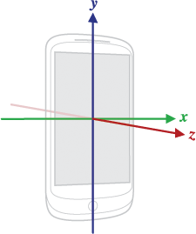
Sensor Coordinate System
In general, the sensor framework uses a standard 3-axis coordinate system to express data values. For most sensors, the coordinate system is defined relative to the device's screen when the device is held in its default orientation (see Figure). When a device is held in its default orientation, the X axis is horizontal and points to the right, the Y axis is vertical and points up, and the Z axis points toward the outside of the screen face. In this system, coordinates behind the screen have negative Z values. This coordinate system is used by the following sensors:
Acceleration sensor
Gravity sensor
Gyroscope
Linear acceleration sensor
Geomagnetic field sensor
Figure. Coordinate system

Slide 14
Test with the Android Emulator

Slide 15
Note
Don't block the onSensorChanged() method
Sensor data can change at a high rate, which means the system may call the onSensorChanged(SensorEvent) method quite often. As a best practice, you should do as little as possible within the onSensorChanged(SensorEvent) method so you don't block it. If your application requires you to do any data filtering or reduction of sensor data, you should perform that work outside of the onSensorChanged(SensorEvent) method.
Avoid using deprecated methods or sensor types
Several methods and constants have been deprecated. In particular, the TYPE_ORIENTATION sensor type has been deprecated. To get orientation data you should use the getOrientation() method instead. Likewise, the TYPE_TEMPERATURE sensor type has been deprecated. You should use the TYPE_AMBIENT_TEMPERATURE sensor type instead on devices that are running Android 4.0.
Verify sensors before you use them
Always verify that a sensor exists on a device before you attempt to acquire data from it. Don't assume that a sensor exists simply because it's a frequently-used sensor. Device manufacturers are not required to provide any particular sensors in their devices.
Choose sensor delays carefully
When you register a sensor with the registerListener() method, be sure you choose a delivery rate that is suitable for your application or use-case. Sensors can provide data at very high rates. Allowing the system to send extra data that you don't need wastes system resources and uses battery power.

Slide 16
Note
For more information about sensors, please refer to:
https://developer.android.com/guide/topics/sensors/sensors_overview.html#sensors-intro

Slide 17
Task 1
Display Azimuth (X), Pitch (Y) and Roll (Z) Fetched from Orientation Sensor

Slide 18
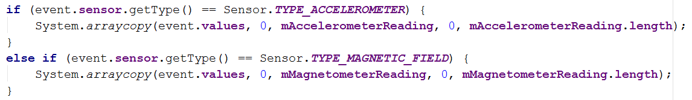
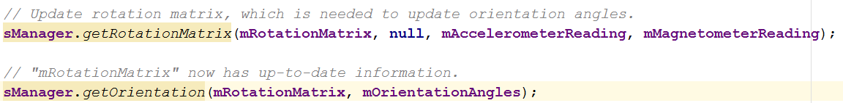
Note
Deprecated

Slide 19
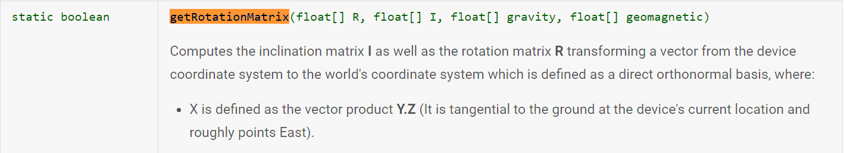
Note
For more information, please refer to:
https://developer.android.com/reference/android/hardware/SensorManager.html#getOrientation(float[], float[])

Slide 20
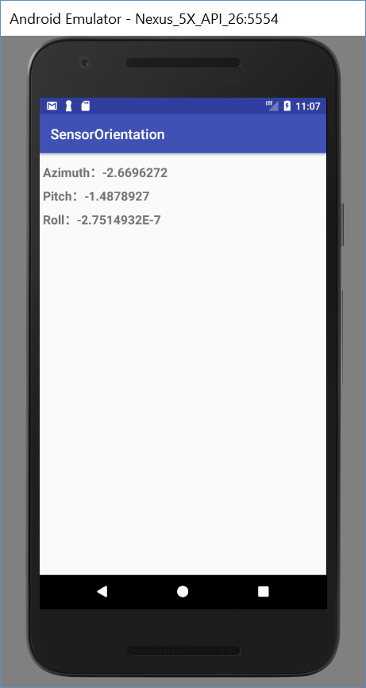
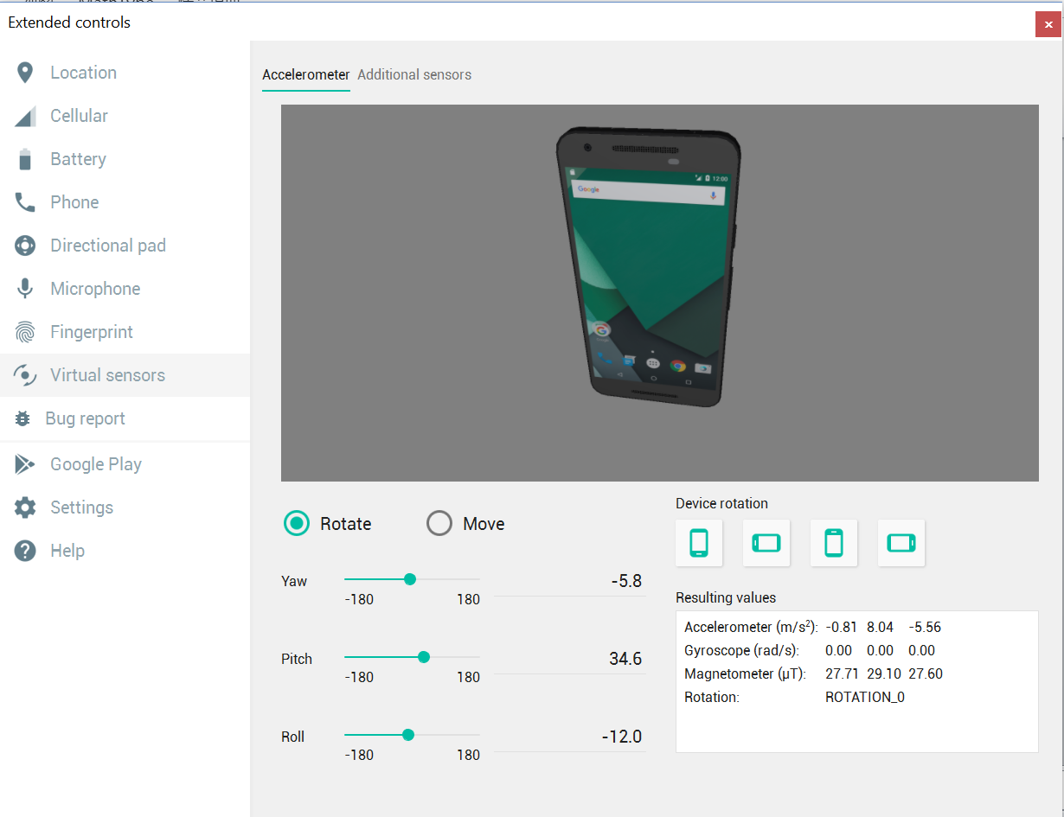
Run the App

Slide 21
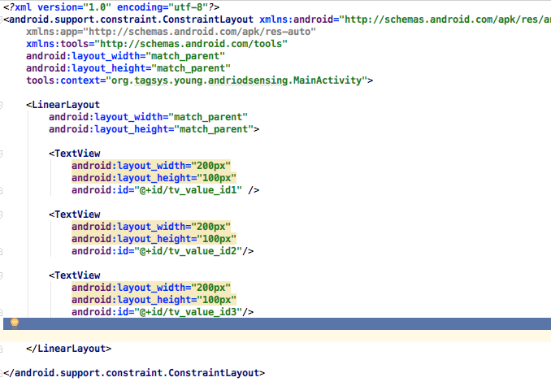
Activity_main.xml

Slide 22
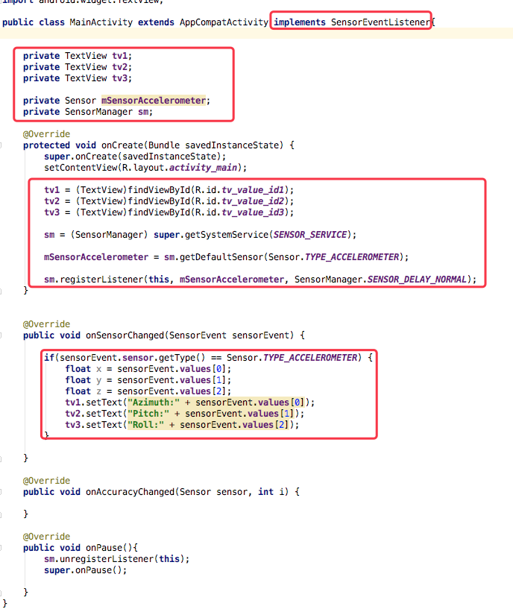
MainActivity

Slide 23
Task 2 (Bonus)
Display the Orientation in Degree

Slide 24
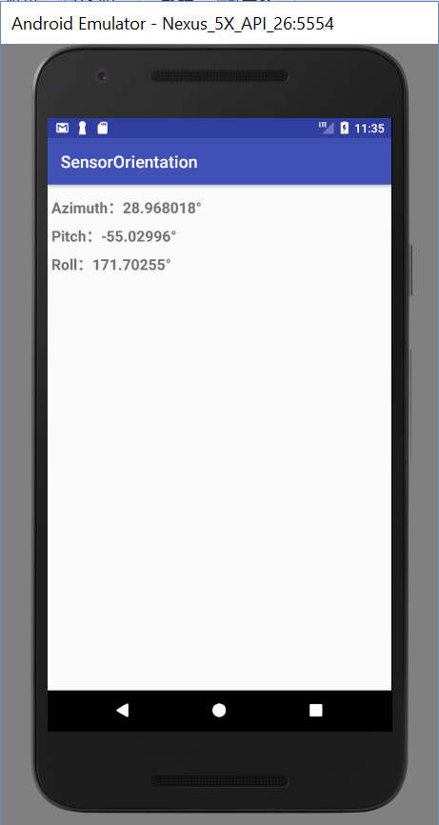
Conversion from Rad to Degree
Degree = (Rad * 180) / PI
Math.toDegrees()

Slide 25
Task
Please capture and upload the screenshots of your Android app developed during the lab class

Slide 26
THANK YOU!

